Slide 1
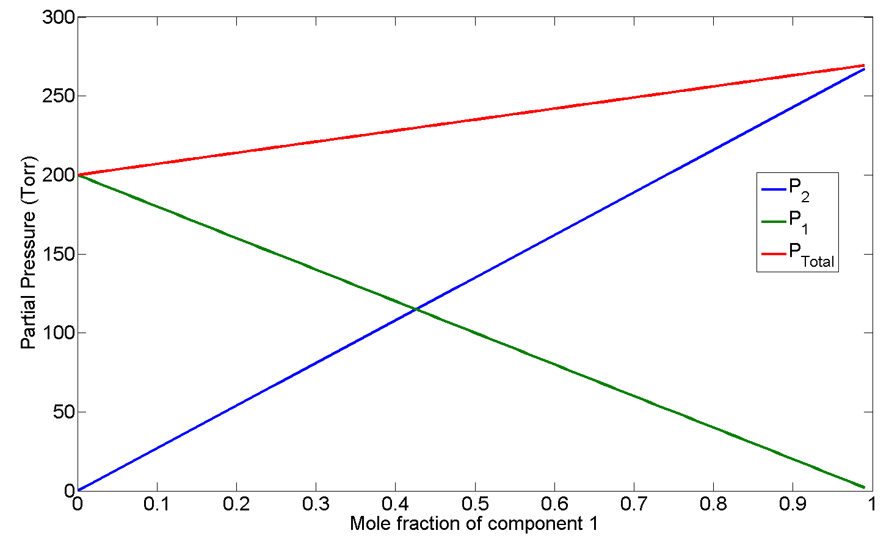

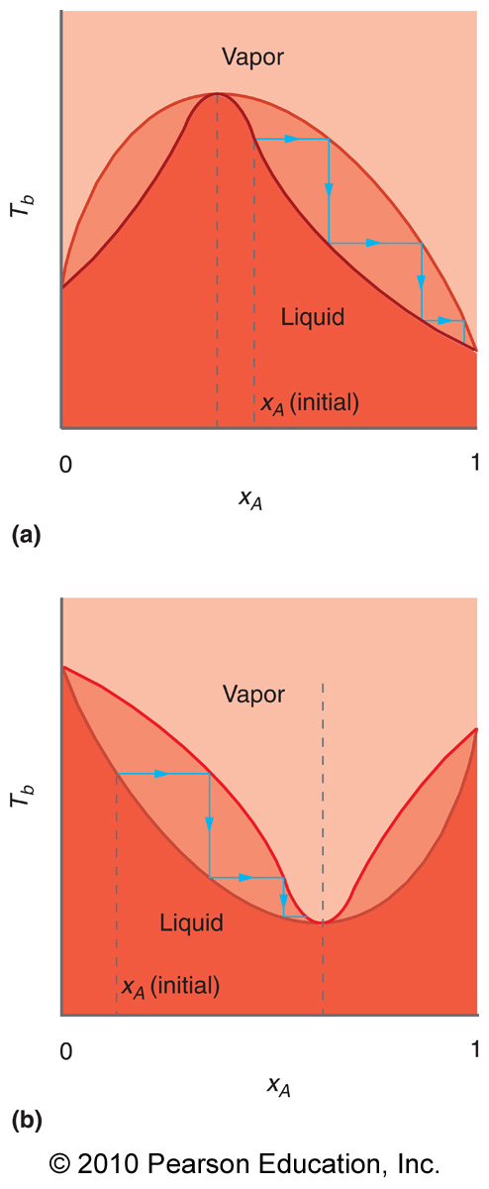
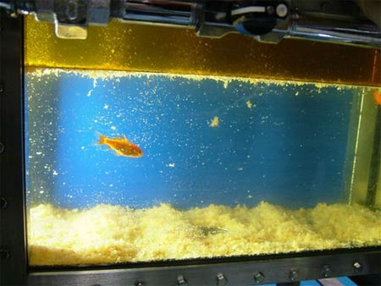
CHEM 450/450G
Dr. M. J. Nee
Lecture II-5
Binary Solutions: Raoult’s and Henry’s Laws
Plan for Today:
Raoult’s and Henry’s Law
Binary solutions and Raoult’s Law
Fractional distillation
Gibbs-Duhem Equation
Binary Phase Diagrams

Slide 2
Solutions: What do we want to know?
1. How does vapor pressure change vs. pure solvent?
Henry’s and Raoult’s Laws
2. To what extent are things soluble and why?
Thermodynamics of mixing
3. What makes solutions deviate from ideal behavior?
Solvent-solute interactions
4. How can we separate solutions, and to what extent?
Fractional distillation and binary mixtures
5. What is the chemical origin of colligative properties?
Chemical potential changes
6. How does chemistry change in solution?
Equilibrium in solutions

Slide 3
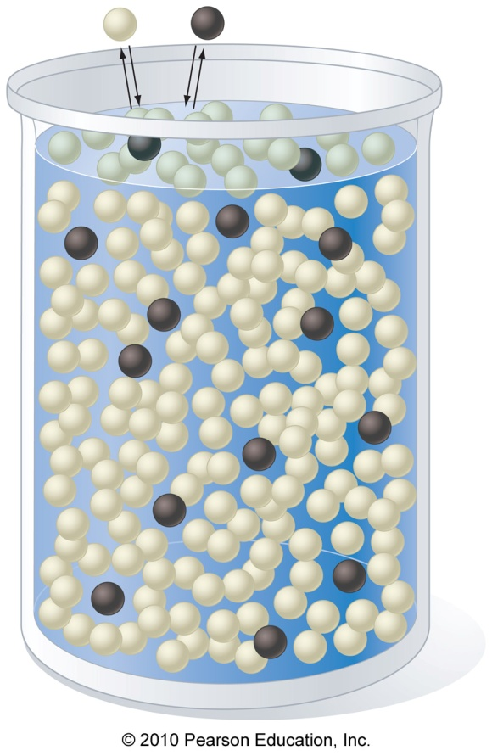
Ideal solutions obey Raoult’s Law
For an ideal solution, the vapor pressure of the solvent (P_{i}) over a dilute solution of composition x_{i}, is directly proportional to the vapor pressure of the pure solvent, P_{i}*:
Away from x_{i} = 1, all real solutions deviate from this law.

Slide 4
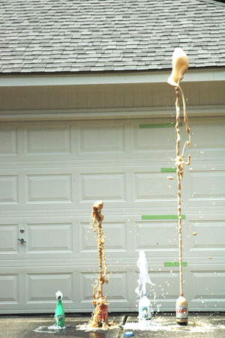
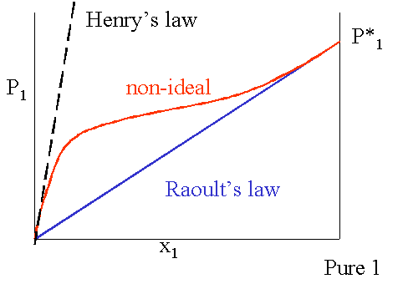
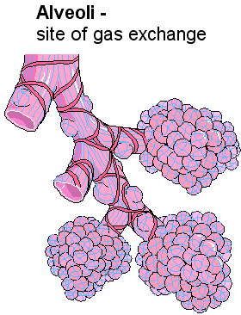
Henry’s Law: Vapor pressure of solute
The vapor pressure of the solute depends instead on an empirical proportionality constant, k_{H} (the Henry’s Law constant):

Slide 5
Solutions and Chemical Potential
We can express the chemical potential of component i in the solution by adding a mixing term to the chemical potential of the pure solvent:
Remember, μ_{i} = G_{i,m}, so we can always just go to the tables to find μ_{i}*.
Why might we want to do this?

Slide 6
Thermodynamics of mixing in solutions
Note that, conveniently enough, the thermodynamic parameters of mixing are effectively the same for ideal solutions as they were for ideal mixtures of gases:
For Ideal Solutions!

Slide 7
Binary Solutions: Ideal behavior
The vapor pressure above an ideal binary solution is also well-described by Raoult’s law, which means

Slide 8
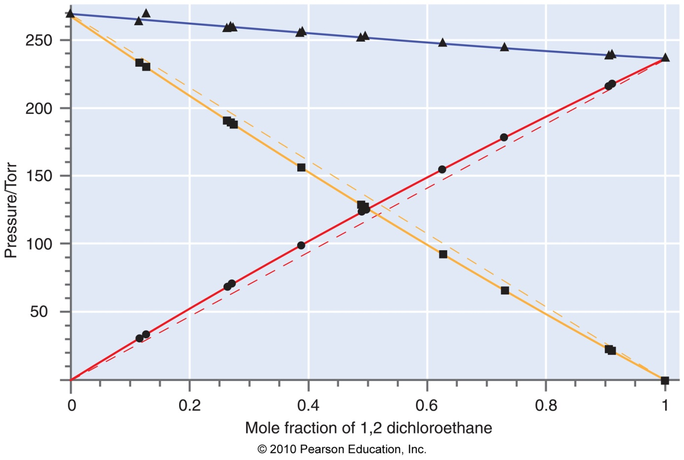
In real solutions, properties are different
Deviations from Raoult’s law happen because real solutions do not obey ΔH_{mix} = 0 and ΔV_{mix} = 0.
Dashed = Raoult’s Law
Solid = Data

Slide 9
Multiple phases, multiple components
For a single component system (one pure compound):
For a multi-component system:
And we must consider the mole fraction as a degree of freedom!

Slide 10
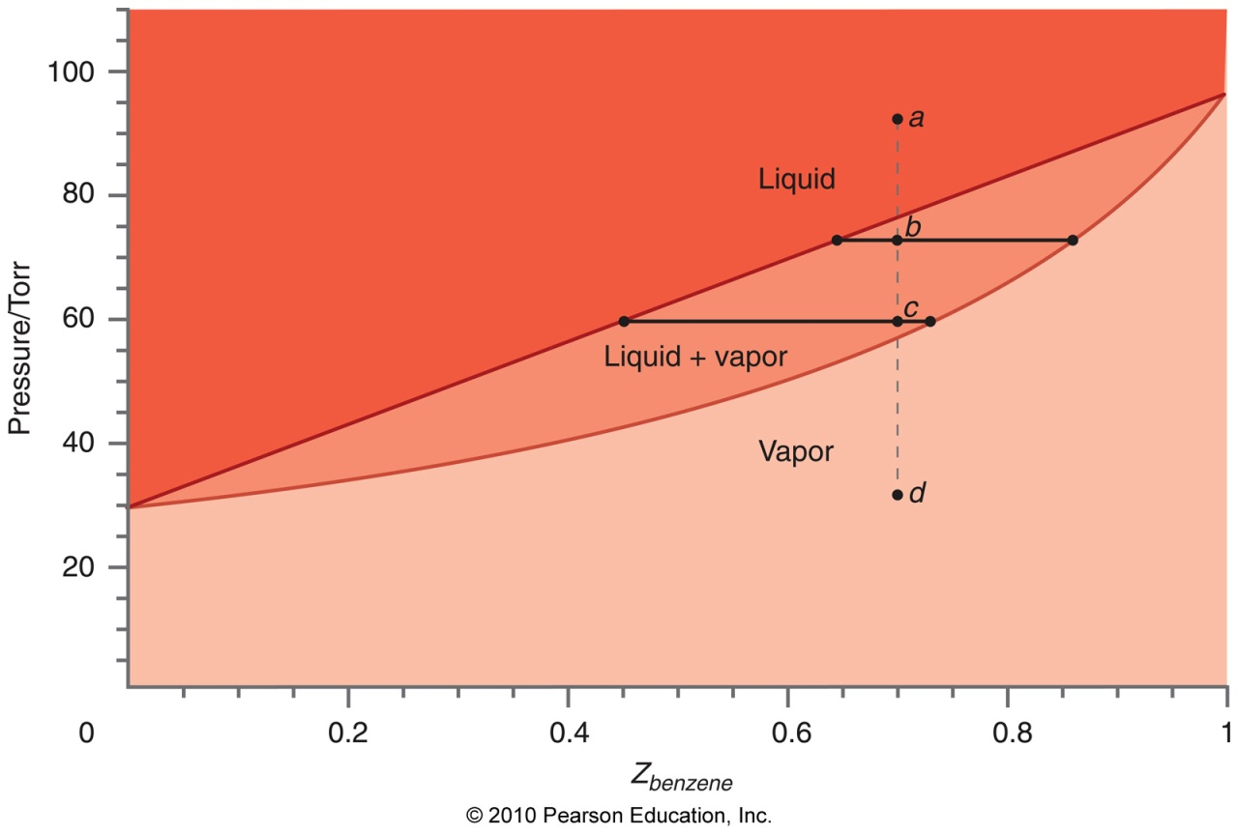
Pressure-composition diagrams
We now have a new variable, x_{i}, the mole fraction of a given component. The mole fraction in the liquid (x_{i}) is not the same as the mole fraction in the vapor (y_{i})!

Slide 11
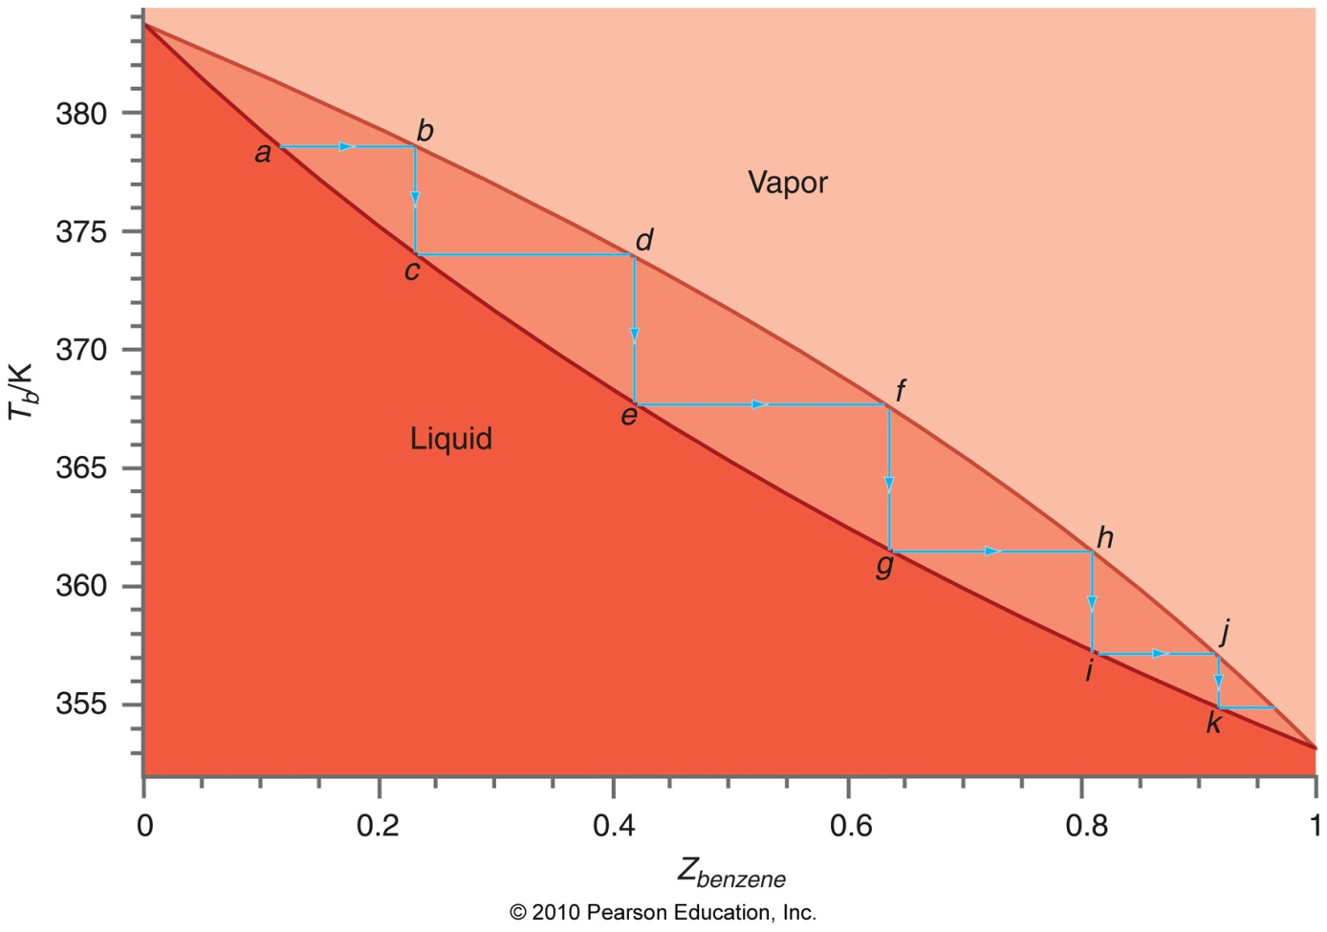
Fractional distillation (T-x diagrams)
Start with a given composition (x_{A}) of two miscible liquids, A and B. You heat it, then let the vapor condense away (distillation) until T increases again. How pure is what remains?
What if you did this repeatedly?

Slide 12
Azeotropes
At azeotrope , the liquid and vapor compositions are the same – no further distillation can happen!

Slide 13
Chemical potentials in solution are not independent!
So far, only discussed solutions of two volatile substances: both have measurable vapor pressures in the region of interest.
Thus, chemical potential of the solvent changes with composition! We can make use of this to measure the chemical potential of a non-volatile component.

Slide 14
The Gibbs-Duhem Equation
Differential for Gibbs energy:
At constant P, T, we deal only with .
To be proper, we would write:
In fact, this means the what we assume is that

Slide 15
Using the Gibbs-Duhem Equation
If we have a non-volatile component, the change in its chemical potential is known as long as we know the change in chemical potential of the volatile component:

Slide 16
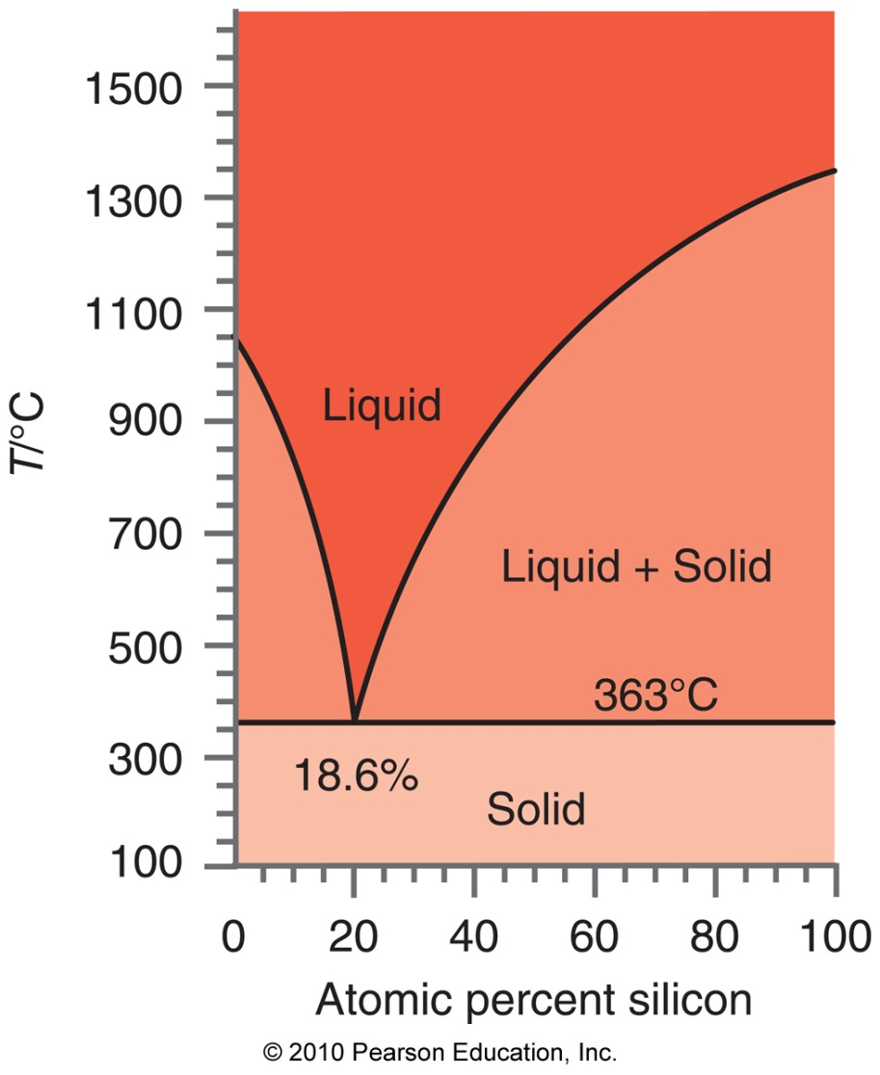
Binary Phase diagrams
When a liquid-liquid solution cools, there is a liquid-solid coexistence region. In this region, there are 2 degrees of freedom!
Eutectic point: no L+S region exists – go straight from S to L.

Slide 17
Solid-solution equilibrium
For dilute solutions, the solute begins to freeze out at T, defined by
(prove
next time)
where T*_{fus} and ΔH*_{fusion,m} are the freezing T and ΔH of the pure solvent, respectively.
How could we determine the eutectic temperature, T_{E}?

Slide 18
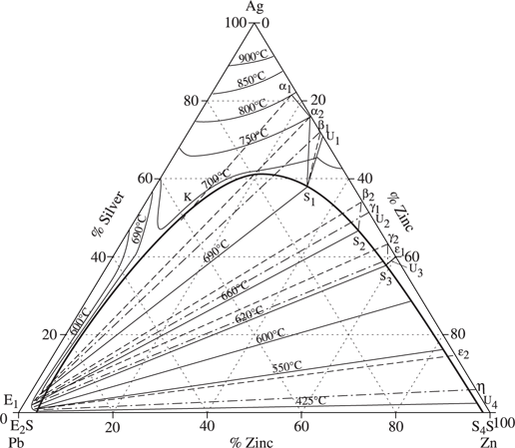
Ternary Phase Diagrams

Slide 19
Reading: Finish up chapter 9. We will cover colligative properties next, then spend a day on real solutions and activities.
Homework 6 is due 10/22. Today and the next few lectures are generally distributed throughout HW6 and 7.

